Slide 1




Next Gen Employability Program
Full Stack Web Development with AI Tools
Team Details – NG_CP_Team_251
Name: Ujjwal Singh
Name: Priyanka Saini
Name: Rajat Gupta
Name :Ankit Pandey
College: Meerut Institute of Technology,
Meerut

Slide 2

The content is curated from online/offline resources and used for educational purpose only.
Notes:
Speaker would be briefing the students that this content has been prepared for the educational purpose only and is referred from multiple sites which are cited in the last.​​
---------------------------------------------------​​
A disclaimer is a statement or notice that is intended to clarify, limit, or provide information about the scope, limitations, or potential risks associated with certain actions, information, products, services, or content. ​​
​​
​

Slide 3

Project Title
Nagar Nirvana-Citizen Grievance Redressal System
Notes:
In this slide speaker will be introducing the program and its outcomes. The speaker will introduce himself in brief

Slide 4

Table of Contents
Introduction
Problem Statement
Proposed Solution
Key features
Technology stack
System flowchart
Core Modules
Security measures
Conclusion and Future work
References
Notes:
This slide, The speaker will talk about the content that we will be covering in this session as follows:
Introduction
Importance of UI/UX in industry
History and Definitions of UI and UX
Key Differences between UI/UX
Use Cases
Significance in Web Development
Use Cases
Visual Design Principles
Design process
Color theory and psychology
Typography and readability
Layout and Spacing
Responsive design basics
Usability and Accessibility
Usability Aspects
Web Content Accessibility Guidelines (WCAG)
Inclusive design practices
Consistency
User Experience
User-Centered Design
User research methods
Interactive Elements and Feedback
Mini Case Study
Discussing a popular UI/UX design
Hands-On
Introduction to Figma for UI/UX design

Slide 5
.
INTRODUCTION:
In modern smart cities, citizens often face difficulties in reporting civic issues such as road damage, garbage, water supply, or streetlight problems .The traditional complaint system is mostly manual, time-consuming, and lacks transparency.
Nagar Nirvana is a digital grievance redressal platform that enables citizens to report complaints easily, track their status in real time, and provide feedback after resolution. This system improves communication between citizens and authority and supports smarter city governance.
Notes:
This slide, The speaker will talk about the content that we will be covering in this session as follows:
Introduction
Importance of UI/UX in industry
History and Definitions of UI and UX
Key Differences between UI/UX
Use Cases
Significance in Web Development
Use Cases
Visual Design Principles
Design process
Color theory and psychology
Typography and readability
Layout and Spacing
Responsive design basics
Usability and Accessibility
Usability Aspects
Web Content Accessibility Guidelines (WCAG)
Inclusive design practices
Consistency
User Experience
User-Centered Design
User research methods
Interactive Elements and Feedback
Mini Case Study
Discussing a popular UI/UX design
Hands-On
Introduction to Figma for UI/UX design

Slide 6
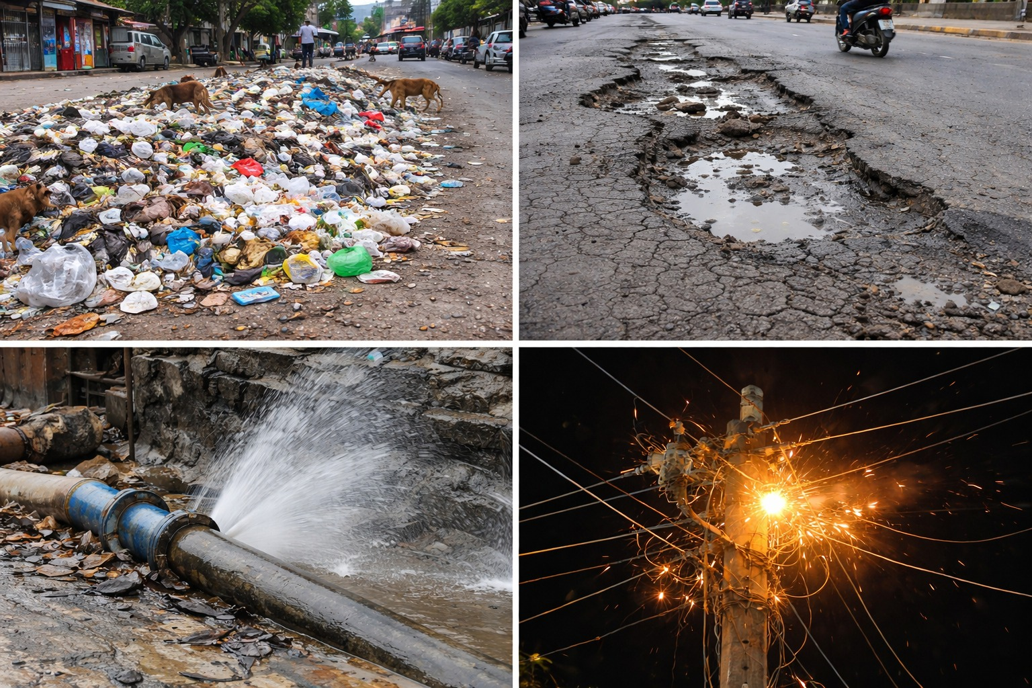
PROBLEM STATEMENT:
Citizens face delays and lack of transparency while reporting
civic issues
Complaint tracking is mostly manual and inefficient
Authorities do not have centralized visibility of complaints
No real-time status updates for citizens
Difficulty in identifying complaint trends and hotspots
Notes:
This slide, The speaker will talk about the content that we will be covering in this session as follows:
Introduction
Importance of UI/UX in industry
History and Definitions of UI and UX
Key Differences between UI/UX
Use Cases
Significance in Web Development
Use Cases
Visual Design Principles
Design process
Color theory and psychology
Typography and readability
Layout and Spacing
Responsive design basics
Usability and Accessibility
Usability Aspects
Web Content Accessibility Guidelines (WCAG)
Inclusive design practices
Consistency
User Experience
User-Centered Design
User research methods
Interactive Elements and Feedback
Mini Case Study
Discussing a popular UI/UX design
Hands-On
Introduction to Figma for UI/UX design

Slide 7
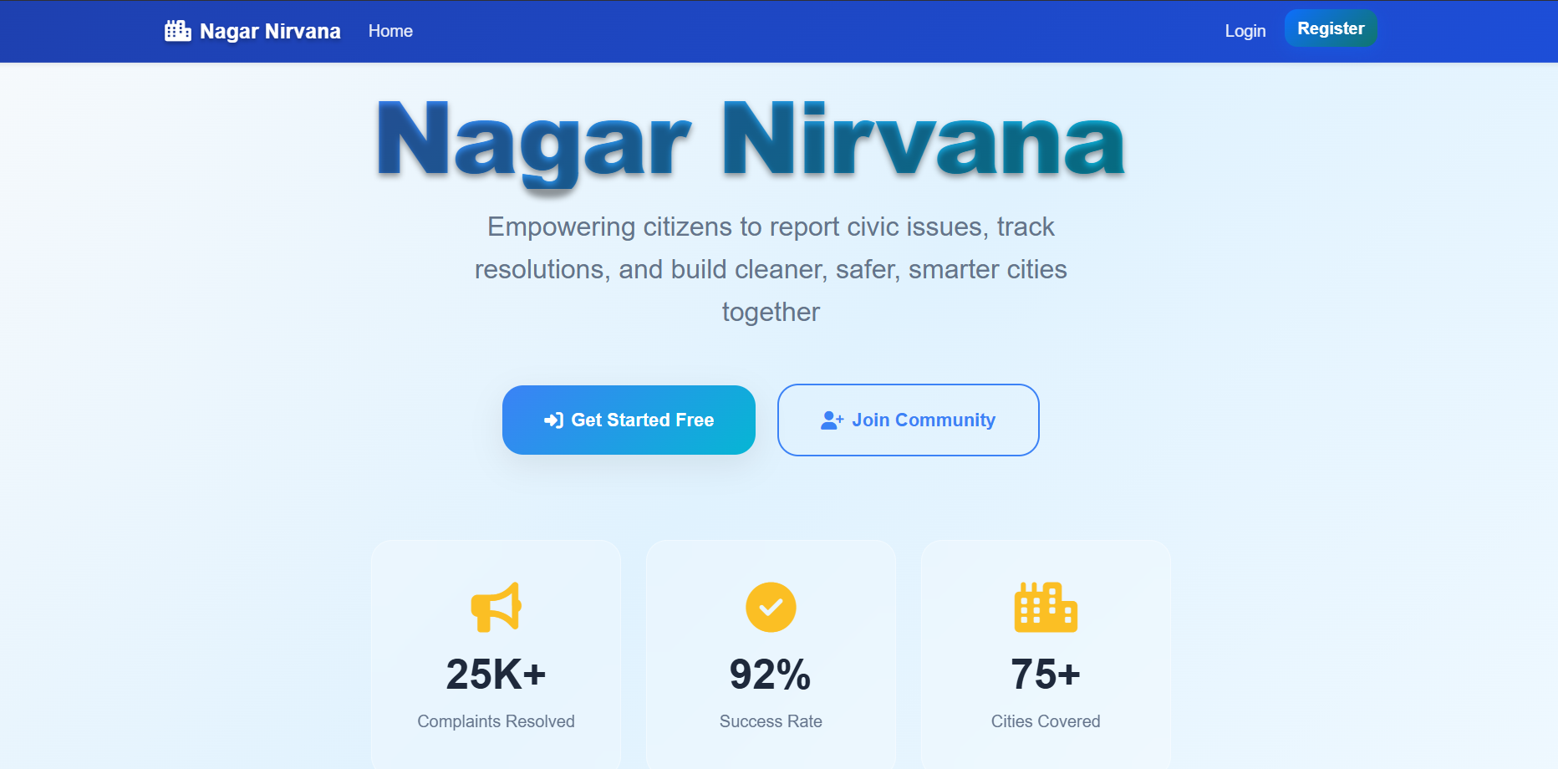
PROPOSED SOLUTION:
A web-based Citizen Grievance Redressal System
Citizens can submit complaints with location and media
Real-time status tracking of complaints
Authorities manage, update, and resolve complaints
efficiently
Feedback system ensures accountability and transparency
Map-based visualization for better monitoring
Notes:
This slide, The speaker will talk about the content that we will be covering in this session as follows:
Introduction
Importance of UI/UX in industry
History and Definitions of UI and UX
Key Differences between UI/UX
Use Cases
Significance in Web Development
Use Cases
Visual Design Principles
Design process
Color theory and psychology
Typography and readability
Layout and Spacing
Responsive design basics
Usability and Accessibility
Usability Aspects
Web Content Accessibility Guidelines (WCAG)
Inclusive design practices
Consistency
User Experience
User-Centered Design
User research methods
Interactive Elements and Feedback
Mini Case Study
Discussing a popular UI/UX design
Hands-On
Introduction to Figma for UI/UX design

Slide 8

KEY FEATURES: CITIZEN
• User registration and login • Submit complaints with Category, Priority, Location (GPS)
Media attachments • Track complaint status in real time • View complaints on interactive map • Submit feedback after resolution • Chatbot support for assistance

Slide 9

KEY FEATURES: AUTHORITY
• Authority dashboard overview • View and manage all complaints • Update complaint status with comments • Maintain complete status audit trail • Analyze complaints using charts • Review citizen feedback before closing complaint

Slide 10

TECHNOLOGY STACK:
Frontend
• HTML, CSS, JavaScript
Backend
• Django 5.2 (Python)
Database
• SQLite
Maps
• OpenStreetMap (Leaflet)
Development Tools
• VS Code

Slide 11
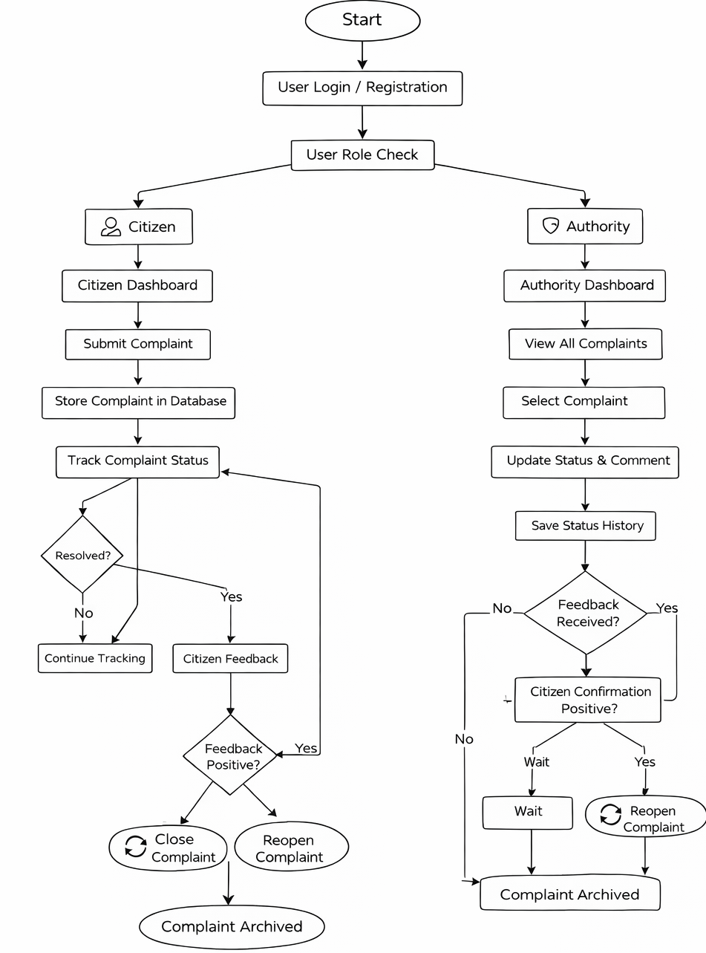
SYSTEM FLOWCHART:

Slide 12
CORE MODULES:
User Module
Complaint Submission Module
Complaint Tracking Module
Authority Dashboard Module
Feedback Module

Slide 13
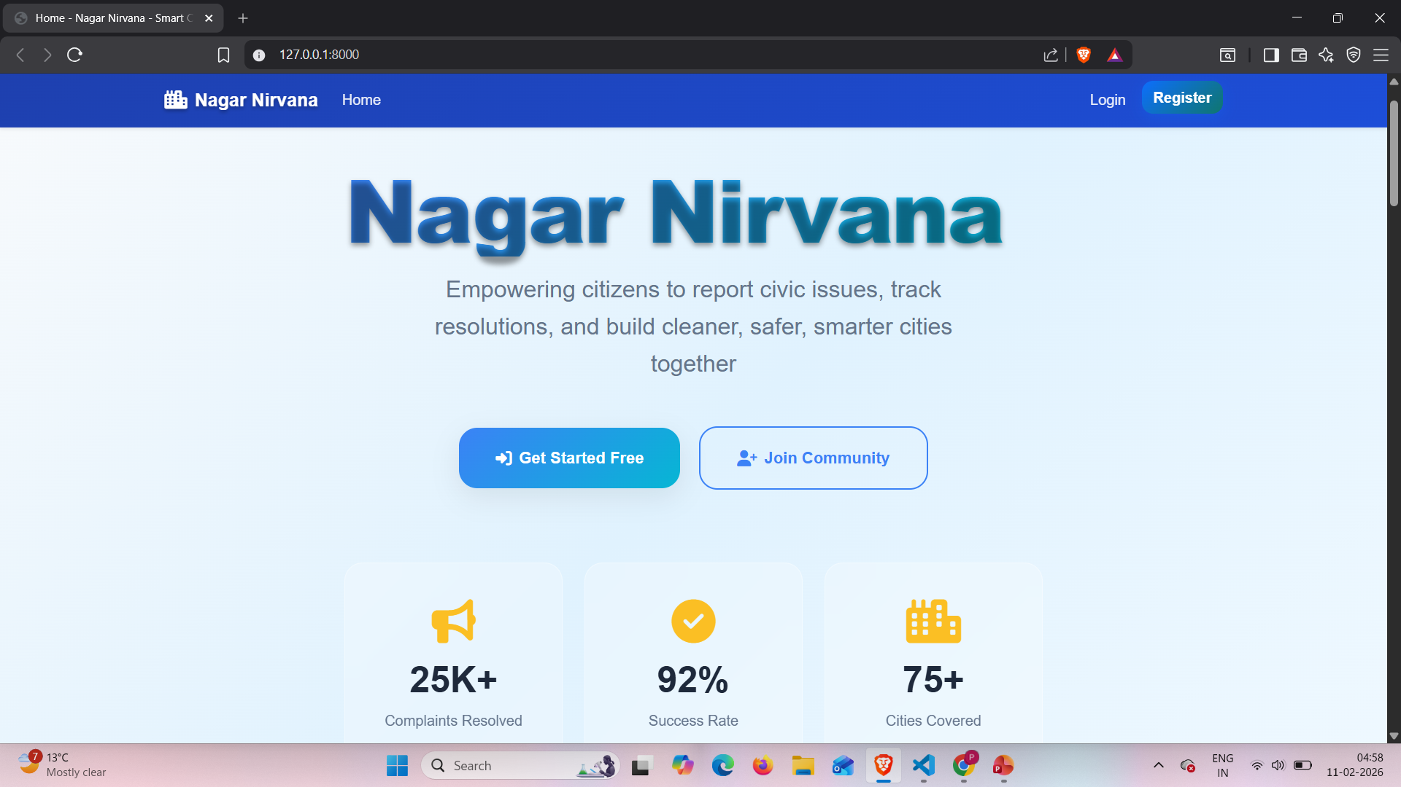
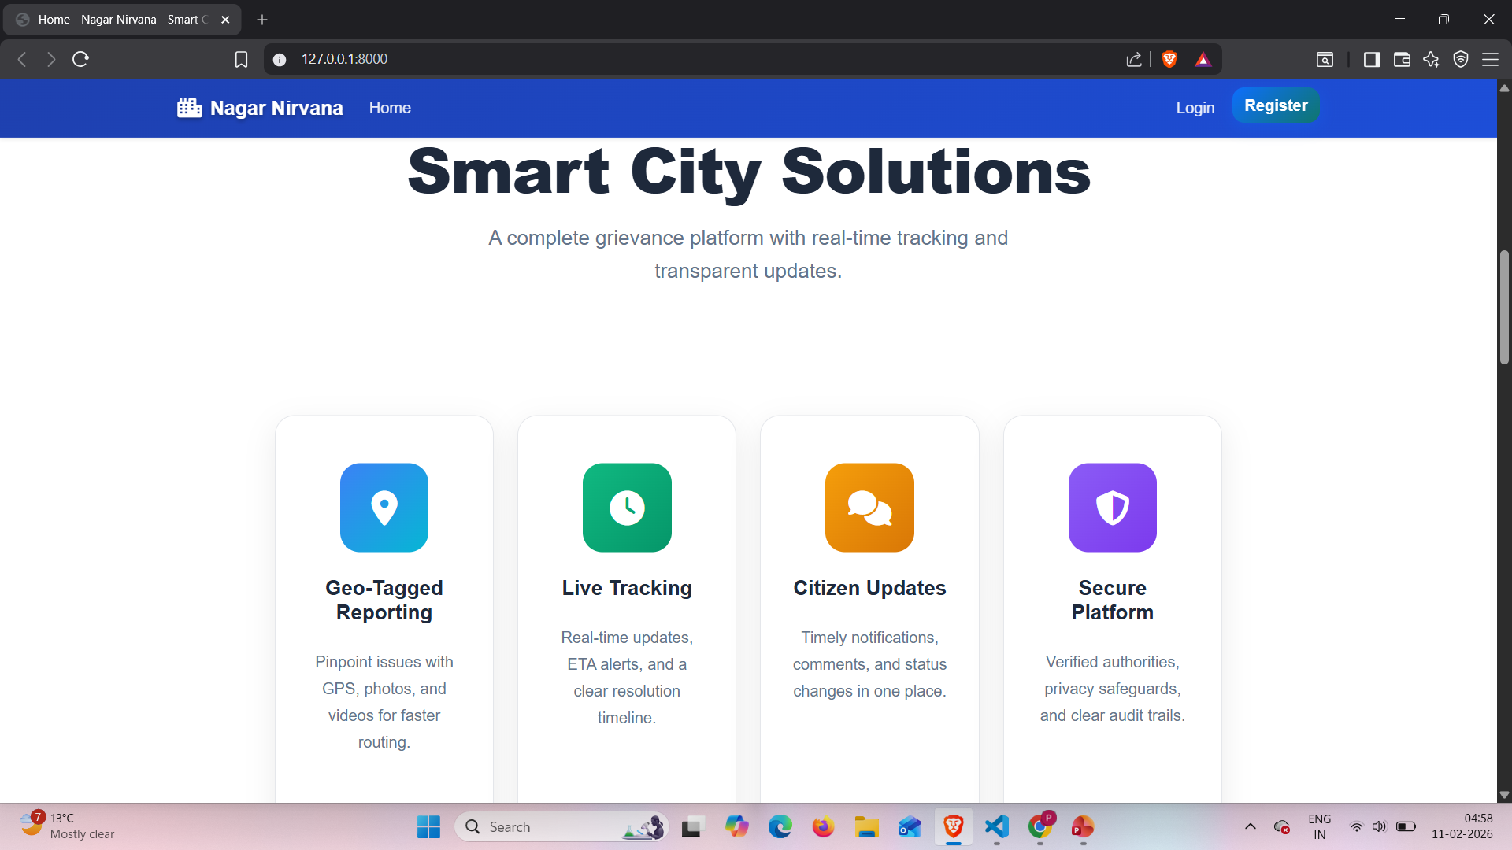

Slide 14
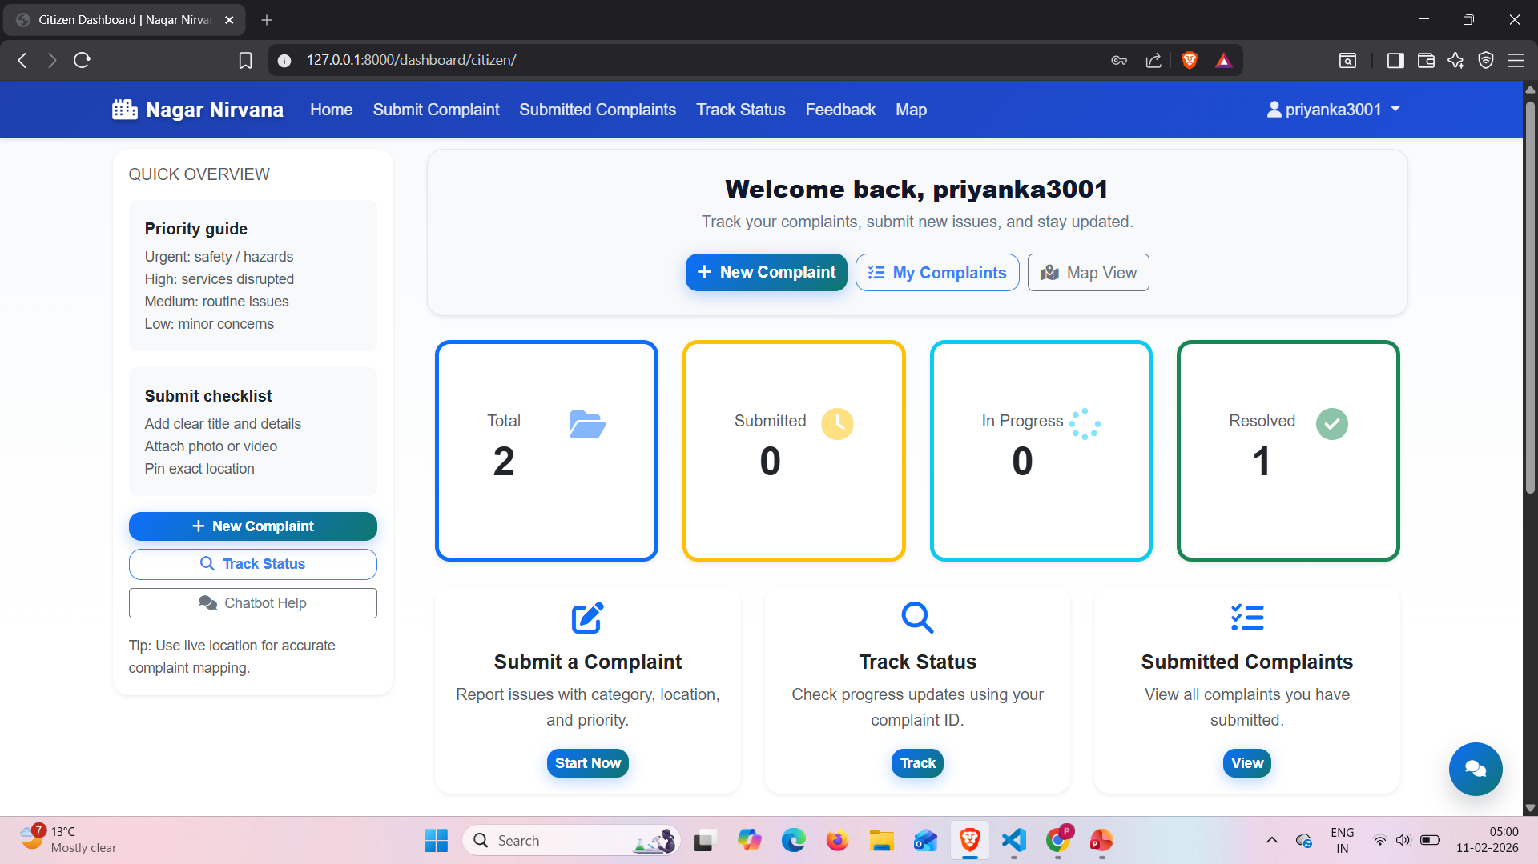

Slide 15
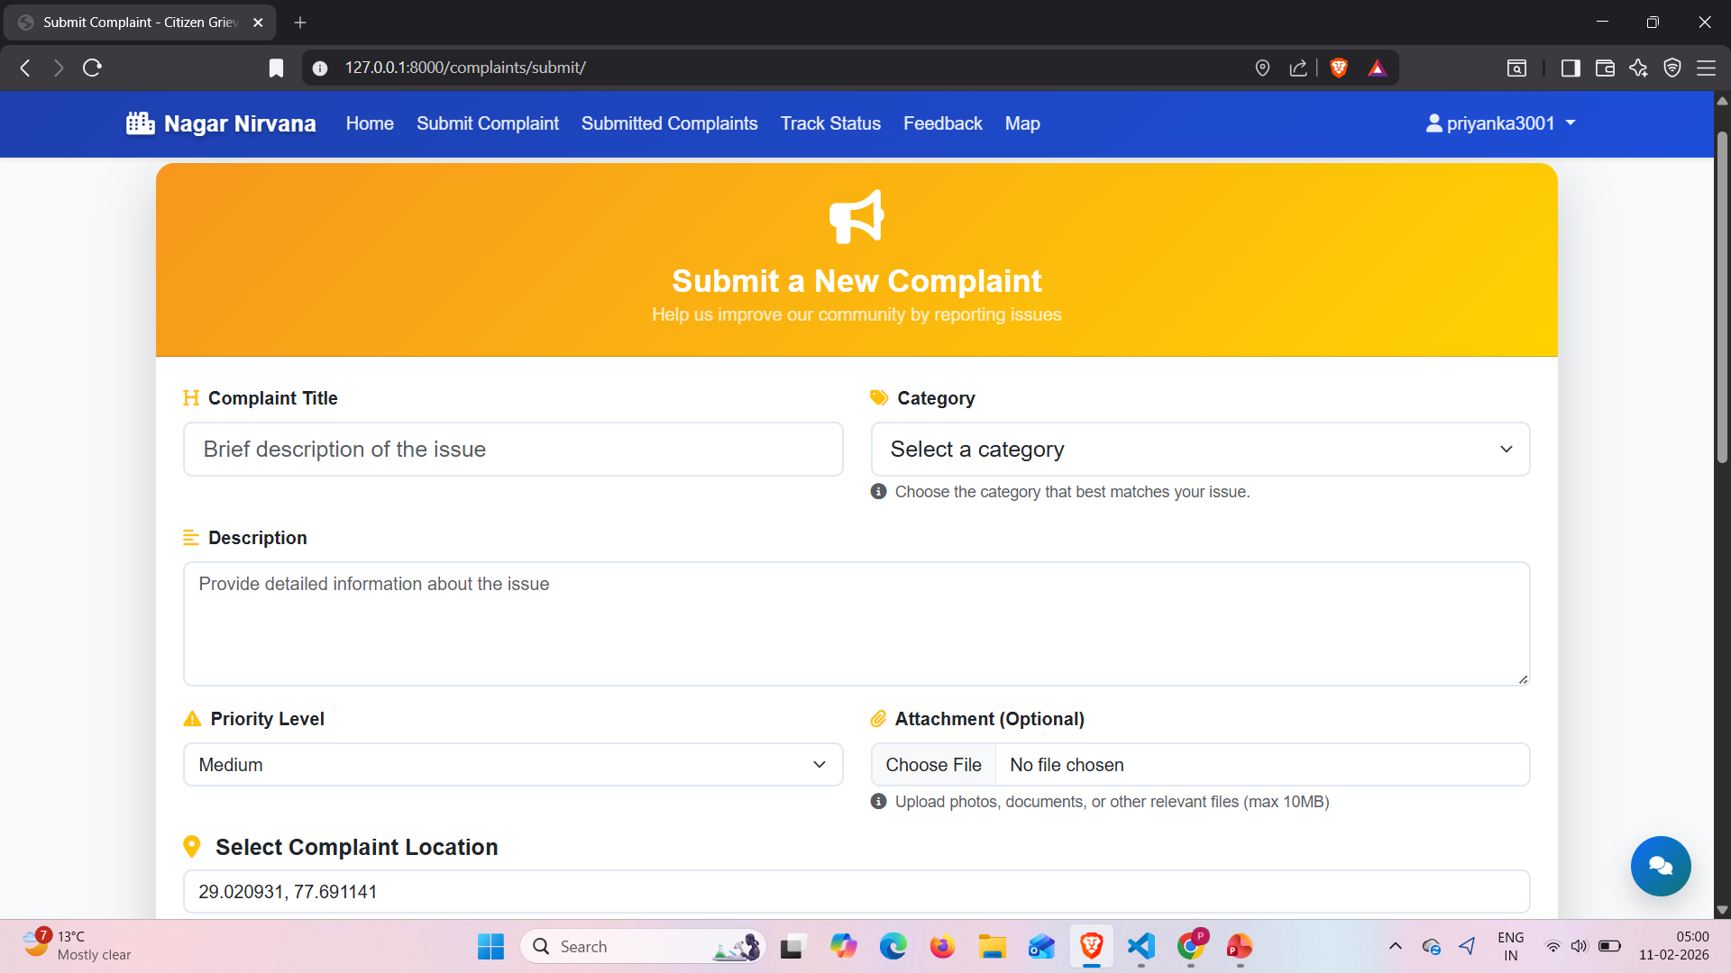
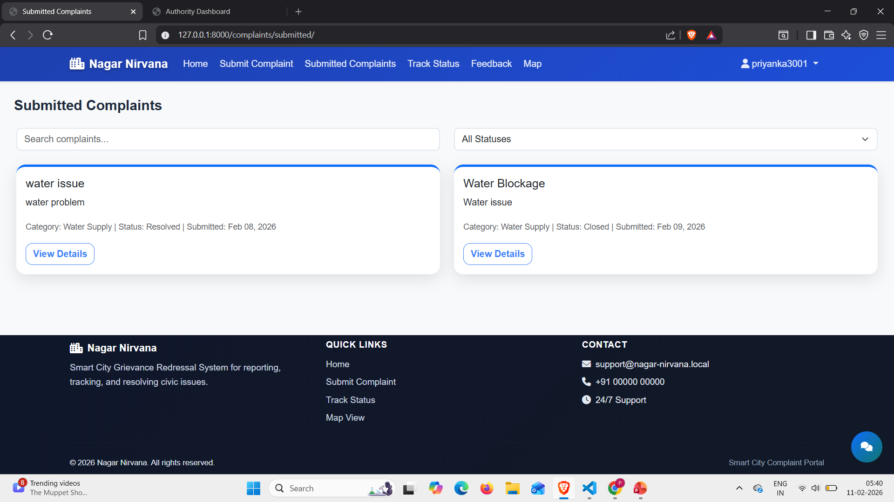

Slide 16
CONCLUSION: FUTUREWORK:
Mobile application for citizen convenience
AI chatbot for automated support and guidance
Advanced analytics to identify issue trends and hotspots
Admin dashboard for city-level monitoring
Migration to PostgreSQL for scalability and performance
Improves communication between citizens and authorities.
Reduces manual work and delays in grievance handling
Increases accountability through feedback and status updates
Supports efficient and smarter city governance
Provides a digital platform for citizens to report civic issues easily
Ensures transparent and real-time complaint tracking
SMS and email notifications for complaint updates

Slide 17
REFERENCES:
ChatGPT – https://chat.openai.com
Django Documentation – https://docs.djangoproject.com
MySQL Official Documentation – https://dev.mysql.com/doc/
Bootstrap Documentation – https://getbootstrap.com/docs/
MDN Web Docs – HTML, CSS, JavaScript Reference – https://developer.mozilla.org
Notes:
This slide, The speaker will talk about the content that we will be covering in this session as follows:
Introduction
Importance of UI/UX in industry
History and Definitions of UI and UX
Key Differences between UI/UX
Use Cases
Significance in Web Development
Use Cases
Visual Design Principles
Design process
Color theory and psychology
Typography and readability
Layout and Spacing
Responsive design basics
Usability and Accessibility
Usability Aspects
Web Content Accessibility Guidelines (WCAG)
Inclusive design practices
Consistency
User Experience
User-Centered Design
User research methods
Interactive Elements and Feedback
Mini Case Study
Discussing a popular UI/UX design
Hands-On
Introduction to Figma for UI/UX design

